Slide 1
Stock Market Analysis
Present By :Pramita Chakraborty
Date :15/12/2024

Slide 2
Introduction
1. Investors: Long-term investors use fundamental analysis to evaluate a company’s financial health, growth potential, and stability before investing.
Traders: Short-term traders rely on technical analysis to identify price patterns, trends, and entry/exit points. 11
2. Profit Maximization
Proper analysis uncovers undervalued stocks or short-term trading opportunities.
Timing the market through analysis can lead to better entry and exit points, increasing profits.
3. Understanding Market Trends
Investors and traders can predict future price movements based on historical data and market sentiment.
Identifying bull or bear market conditions helps tailor strategies accordingly.

Slide 3
Market overview
Global Indices
S&P 500 (USA)
Tracks 500 large-cap U.S. companies.
Represents ~80% of the U.S. stock market value.
Indicator of the overall U.S. economy.
Dow Jones Industrial Average (DJIA) (USA)
Tracks 30 large, publicly traded U.S. companies.
Price-weighted index.
NASDAQ Composite (USA)
Includes 3,000+ tech-heavy stocks.
Strong focus on technology and innovation sectors.
FTSE 100 (UK)
Tracks the top 100 companies listed on the London Stock Exchange.
Represents UK market performance.
DAX (Germany)
Tracks the top 40 blue-chip companies on the Frankfurt Stock Exchange.
A key indicator for European markets.
Nikkei 225 (Japan)
Tracks 225 large-cap companies on the Tokyo Stock Exchange.
Reflects Japan's economic health.
Hang Seng Index (Hong Kong)
Tracks the top 50 companies listed on the Hong Kong Stock Exchange.
Reflects China’s market influence.
Tracks all stocks listed on the Shanghai Stock Exchange.
Key indicator of China’s economic health.

Slide 4
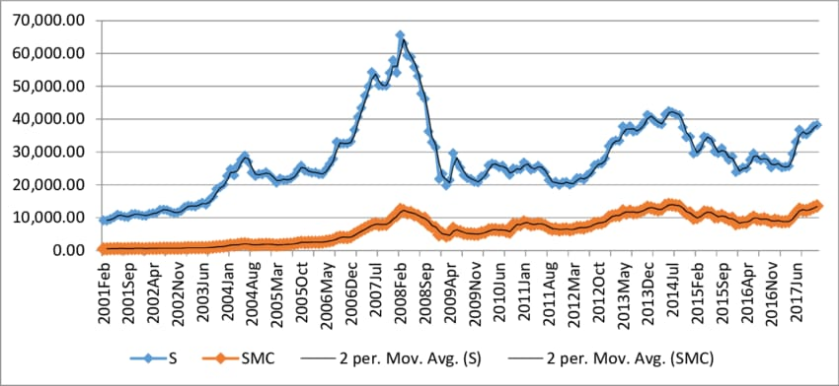
Market trends and performance over time
Market Trends
Overall Market Sentiment: The market is showing slight declines across major indices, indicating cautious investor sentiment.
Sector Performance: Pharma and banking sectors are experiencing mixed performance, with some stocks gaining while others are losing value.
Market Snapshot (as of December 30, 2024)
SENSEX: 78,472.87 (-67.30, -0.09%)
NIFTY 50: 23,727.65 (-25.80, -0.11%)
NIFTY BANK: 51,233.00 (-84.60, -0.16%)
NIFTY Midcap 100: 57,057.90 (-35.00, -0.06%)

Slide 5
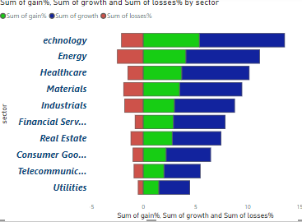
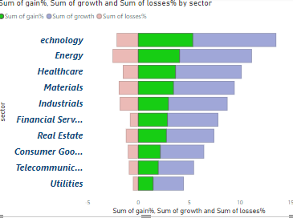
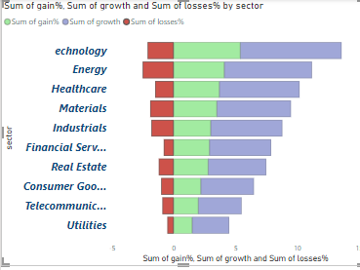
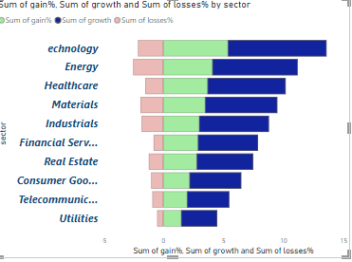
Sector wise performance
Sector wise gain overview
Sector wise performance
Sector wise loss overview
Sector wise growth overview

Slide 6
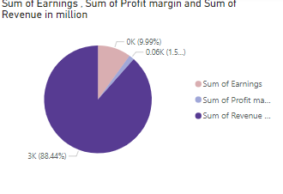
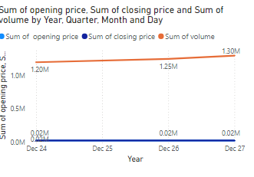
Company Analysis
1.Opening Price: The price at which the stock starts trading at the beginning of the day.
2.Closing Price: The price at which the stock ends trading at the end of the day.
3.Low: The lowest price at which the stock traded during the day.
4.High.: The highest price at which the stock traded during the day.
5.Volume: The number of shares traded during the day.
Stock Revenue, Earnings ,Margin analysis
Stock (opening price,close price and volume by year analysis)

Slide 7
Company news and Announcement
Merck in Pact for Chinese Obesity Drug: Merck has entered into a nearly $2 billion deal with Hansoh Pharma for the Chinese obesity drug. Hansoh Pharma will receive royalties on sales and may co-promote or solely commercialize the drug in China
Brigade Enterprises Launches Net-Zero Residential Project: Brigade Enterprises has launched a net-zero residential project in Bengaluru, with a gross development value of Rs 500 crore.
Foxconn Approaches Nissan: Foxconn is reportedly in talks with Nissan to take a controlling stake.
KFin Technologies Shares Up 30%: KFin Technologies' shares have surged by 30% in a month due to its expansion plans in Southeast Asia
Akzo Nobel India Shares Higher: Akzo Nobel India's shares have risen by 6% on reports of a potential $2-2.5 billion deal for its assets.

Slide 8
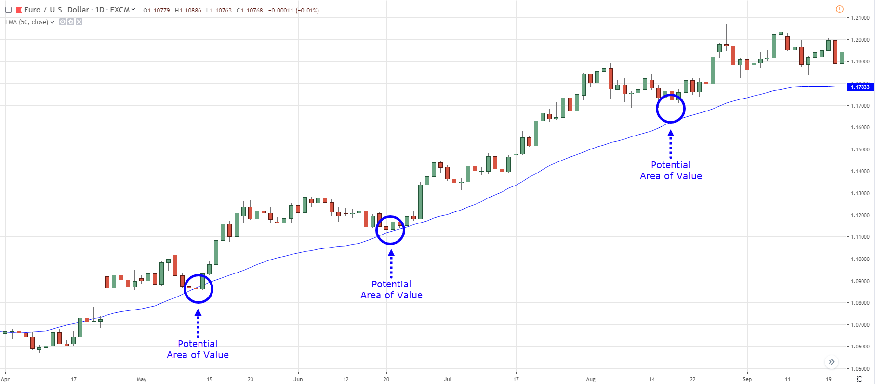
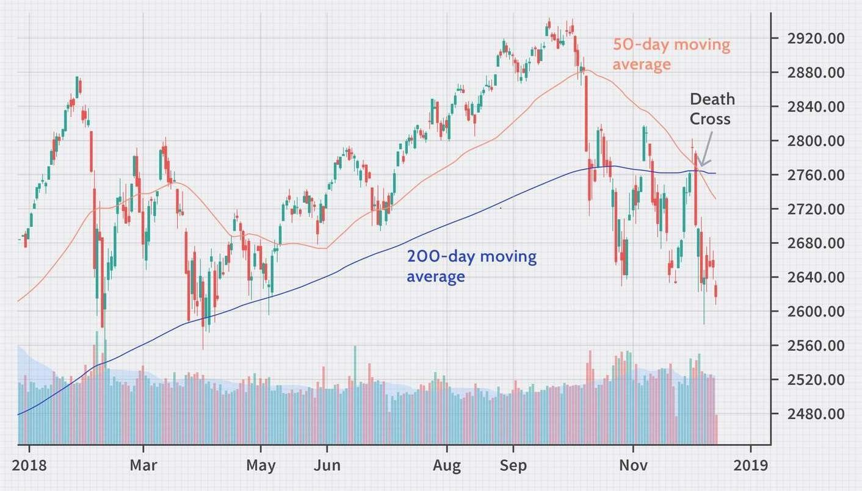
Technical analysis
Moving Averages (MA)
50-Day Moving Average: Indicates the average closing price over the last 50 days. It helps smooth out price data to identify trends.
200-Day Moving Average: Indicates the average closing price over the last 200 days. It's used to determine the long-term trend direction.
Moving Average 50 days analysis
Relative Strength Index (RSI)
RSI (14): Measures the speed and change of price movements on a scale of 0 to 100. An RSI above 70 indicates overbought conditions, while an RSI below 30 indicates oversold conditions.
Moving Average Convergence Divergence (MACD)
MACD (12,26,9): A trend-following momentum indicator that shows the relationship between two moving averages of a stock's price. The MACD line crossing above the signal line indicates a bullish signal, while crossing below indicates a bearish signal
Moving Average 200 days analysis

Slide 9
Real Time Data
For real-time data analysis, I can explore various platforms that provide access to real-time datasets. Here are a few options:
Kaggle: Kaggle offers a wide range of open datasets and machine learning projects. You can explore, analyze, and share quality data on various topics.
Maven Analytics: Maven Analytics provides free datasets and samples for practice. You can download datasets on topics like flight delays, movie ratings, and more.
GitHub - bytewax/awesome-public-real-time-datasets: This GitHub repository lists public real-time datasets and sources, including market data, transportation data, and more.

Slide 10
Conclusion on Market Performance and Technical Analysis
Market Trends and Performance Overview:
The current market trends indicate a cautious sentiment among investors, with slight declines observed across major indices such as the SENSEX and NIFTY 50. The pharmaceutical and banking sectors are showing mixed performance, with certain stocks gaining while others are losing value.
Sector-Wise Performance:
The sector-wise performance dataset highlights the gains, losses, earnings, and growth across various sectors, providing a clear picture of how different industries are performing. Key observations include:
Technology: Exhibiting strong growth with an 8.2% increase.
Healthcare: Showing moderate growth with a 6.5% increase.
Energy: Reflecting solid performance with a 7.1% increase.

Slide 11
Conclusions
1.Stock Price and Technical Analysis
The technical analysis dataset provides valuable insights into stock price movements, trends, and patterns over time. Key indicators such as the 50-day and 200-day moving averages, RSI, MACD, and Bollinger Bands are utilized to understand market dynamics and investor behavior. Notable trends include:
Moving Averages: Smooth out price data to identify long-term trends.
RSI: Indicates overbought or oversold conditions.
MACD: Helps identify bullish or bearish signals.
Bollinger Bands: Highlight volatility and potential price reversals.3
3.Technical Analysis in Power BI
For investors seeking detailed analysis, creating moving average charts in Power BI can be a powerful tool. Using DAX formulas for 50-day and 200-day moving averages, investors can visualize trends and make informed decisions based on historical data and technical indicators.
This conclusion provides a holistic view of market trends, sector performance, and key financial metrics, aiding investors in making well-informed decisions.
2.Company Financial Metrics
The company financial metrics dataset presents key indicators such as revenue, earnings, and profit margin for various companies. This data helps assess the financial health and performance of different organizations, with notable companies like XYZ Corp and ABC Inc showing strong profitability.

Slide 12
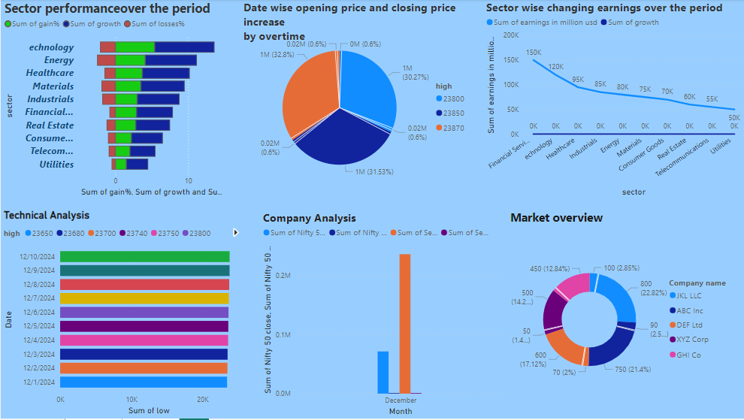

Slide 13
Dashboard Benefits:
Real-Time Data Visualization: Dashboards provide up-to-date information, allowing you to monitor stock prices, forex rates, and commodity prices in real-time.
Improved Decision-Making: By consolidating data into a single view, dashboards help you make informed decisions quickly.
Enhanced Data Understanding: Visual representations make complex data easier to understand, even for non-technical users.
Efficiency: Dashboards save time by eliminating the need to sift through multiple reports and spreadsheets.
Customization: You can tailor dashboards to highlight the metrics and KPIs most relevant to your audience.
Accountability: Dashboards can track performance metrics, fostering accountability and healthy competition within teams.

Slide 14
Thank you

